Slide 1

Unit 1: Analog to Digital or Digital to Analog Converters
Analog to Digital or Digital to Analog Converters
Pre – preparation: Lecture Materials and LIC Text book by ROY Choudhury, sixth edition, 2022.

Slide 2
Unit 6: Analog to Digital or Digital to Analog Converters
A continuous-time signal whose amplitude can take any value; this is the natural form of real-world signals like sound or temperature.
Sampling is a process of taking values of an analog signal at discrete time instants; it converts a continuous-time signal into a discrete-time signal..
After sampling, amplitudes are rounded to a finite set of levels; this introduces quantisation error (noise).
A signal whose amplitude can take only discrete values; it is no longer continuous in magnitude.
Discrete time dignal is defined only at specific time instants; amplitude may still be continuous unless quantised (sampled-data signal case).

Slide 3
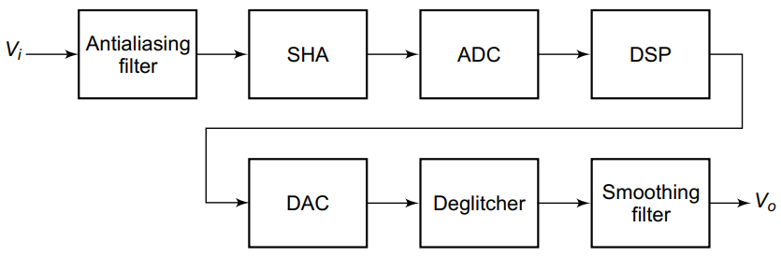
Unit 6: Analog to Digital or Digital to Analog Converters
A continuous-time signal from the output of a transducer is provided to the anti-aliasing filter.
The anti-aliasing filter is low pass filter which makes sure the inout signal frequency is below the half of sampling frequency.
The sample and hold circuit helps in holding the fixed value of continuously changing signal at sampling intervals.

Slide 4
Unit 6: Analog to Digital or Digital to Analog Converters
The ADC converts the fixed analog signal amplitude into the digital form. The output is a digital sequence with discrete values.
DSP block works for the digital signal processing like compression, filtering etc.
The DAC block converts the digital data back to analog form with same sampling frequency.
The deglitecher avoids the unwanted spikes in transition of digital data.
A low-pass filter that smooths the staircase waveform into a continuous analog signal and reduces quantisation noise.

Slide 5

Unit 6: Specifications of DAC
Accuracy: How far the actual DAC output deviates from the ideal expected value for a given digital input.
In a data acquisition system, if DAC is used to generate reference signals, poor accuracy means wrong calibration → entire system becomes unreliable.
For example: If VFS of 3-bit DAC is 8V and the output voltage for 101 is 5.9 V. Find the error.
Stepsize= 8/7=1.14
For 101=5, so analog voltage V0=5*1.14=5.7V
Error =(5.9-5.7)/1.14 = 0.175 V.

Slide 6
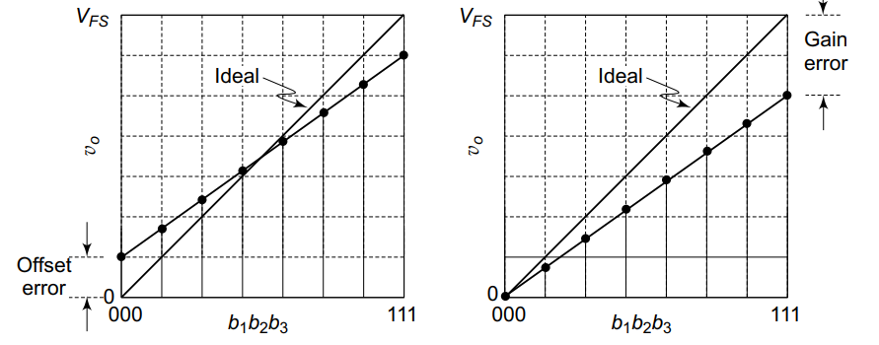
Unit 6: Specifications of DAC
Offset error: Ideally, the output of a D/A converter is 0V when all the bits of binary input word are 0s. In practice, however, there is a very small output voltage called offset voltage or offset error.
The offset error is nullified by translating the actual A/D converter characteristics up or down so that it goes through the origin.
Gain error: Gain error is the deviation in the slope of the DAC transfer characteristic from the ideal slope, after removing offset error.
Gain_error=Fullscale_error- offset error.

Slide 7
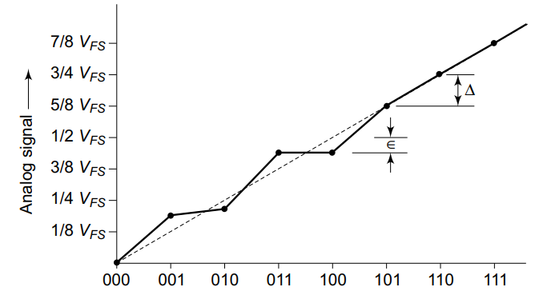
Unit 6: Specifications of DAC
Linearity: The most common dynamic errors are full-scale error and linearity error. Full-scale error is the maximum deviation of the output value from its expected or ideal value, expressed in percentage of full-scale. Linearity error is the maximum deviation in step size from the ideal step size.
Linearity means how evenly the analog output increases for each equal step in digital input (ideal DAC gives perfectly equal steps).
In real DACs, resistor imperfections cause gain and offset errors, so the output deviates from a straight line (non-linear).

Slide 8

Unit 6: Specifications of DAC
Integral Non linearity error is the maximum deviation of actual DAC output from an ideal straight line, after correcting offset and gain errors.
Differential non linearity error is the difference between actual step size and ideal 1 LSB step size.
Monotonocity: A monotonic DAC has increasing values of analog outputs with increase in digital input data. It means as digital data is incremented the output analog data also increments with respect to increase in step size.

Slide 9
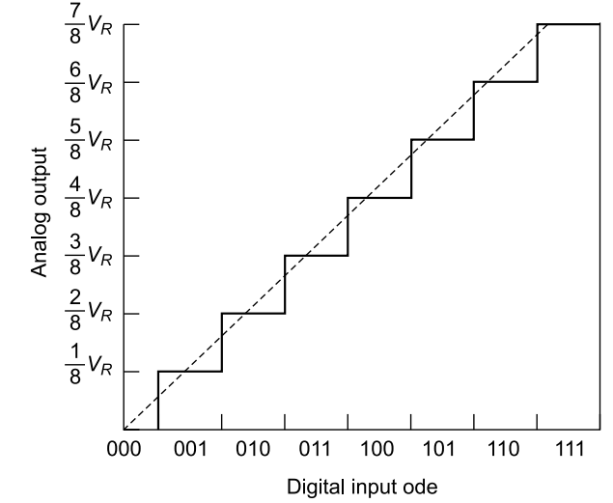
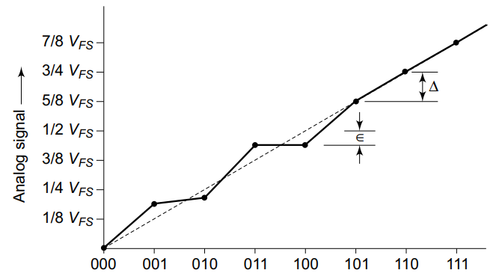
Unit 6: Analog to Digital or Digital to Analog Converters
Non-monotonic
Monotonic

Slide 10



Unit 6: Specifications of DAC
Resolution: Resolution is the smallest change in output corresponding to a 1-bit change (1 LSB).
Settling Time: The time required for the output of a D/A converter to settle down to within ±(1/2) LSB of the final value for a given digital input is known as settling time. It depends on the switching time of the logic circuits, which in turn depends on the inevitable stray capacitances and inductances present in the converter circuit.
Temperature sensitivity: Temperature sensitivity means the analog output changes slightly with temperature even if the digital input is fixed, due to components like reference voltage, resistors, and op-amp.

Slide 11
Unit 6: DAC
A DAC converts an n-bit binary number into a proportional analog voltage or current using a reference voltage.
The binary input D is made of bits b1 ​ (MSB) to bn ​ (LSB), each having decreasing weights 2⁻¹,2⁻²,…,2^{−n}.
Each bit carries either 0 or 1. Adding together you can get binary fractional number.
For example: 101=1⋅2⁻¹+0⋅2⁻²+1⋅2⁻³=(1/2)+0+(1/8)​=0.625
DAC converts this fractional number D into a scaled analog value using a reference voltage VR (VFS)​:

Slide 12
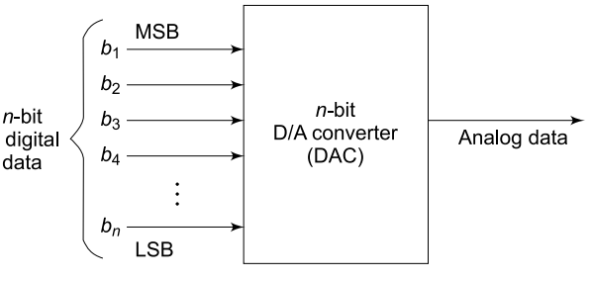
Unit 6: DAC
The MSB contributes the largest portion (VFS/2), while the LSB contributes the smallest (VFS​/2^{n}).
The output voltage is the sum of all bit contributions, scaled by a factor K (usually 1).
So, the analog output is directly proportional to the digital input value.

Slide 13
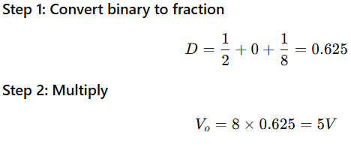


For a full scale output voltage of 8 V find the analog output voltage of the binary data 101. Assume scaling factor of 1.
For a full scale output voltage of 16 V find the analog output voltage of the binary data 1101.

Slide 14
Unit 6: Weighted resistor DAC
A binary-weighted resistor DAC is one of the simplest ways to convert digital data into an analog signal.
It converts each bit of a digital input into a proportional analog contribution, and then adds all contributions together to form the final output.
Instead of doing digital multiplication, the circuit uses resistors since I=V/R
The circuit assigns different resistor values to different bits so that each bit creates a different current contribution.
LSB gets the largest resistor. Each more significant bit gets half the resistor. therefore, each more significant bit contributes twice the effect of the next lower bit.

Slide 15
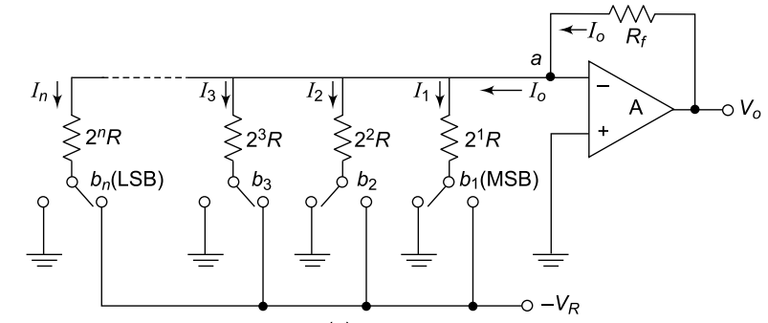
Unit 6: Weihted resistor DAC
Each bit controls a switch. The switch has two positions: If the bit is 1, it connects to the reference voltage −VR else it connects to ground.
So each bit either contributes a weighted current from the reference, or no contribution at all.
The Op-amp is used as the summing amplifier. The currents are all added at the inverting terminal of Op-amp.
The Op-amp converts this
Current into voltage as the
Drop across the resistor Rf.

Slide 16
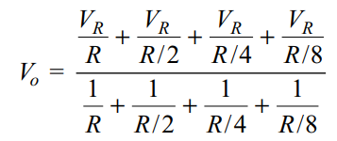
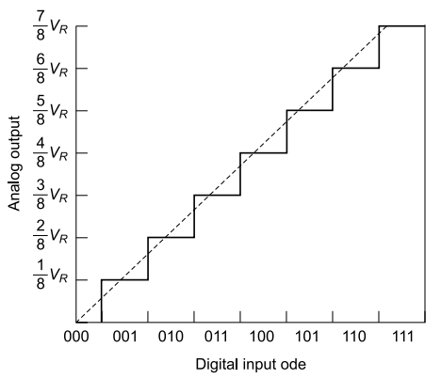
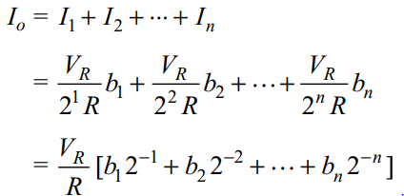

Unit 6: Weihted resistor DAC
Considering an ideal Op-amp the current I0 is given as:

Slide 17
Unit 6: Drawbacks of Weighted resistor DAC
Binary weighted DAC needs a wide range of resistor values; as bit count increases, resistor ratios become very large (e.g., 128:1 for 8-bit).
Such large resistors are hard to fabricate accurately and cause errors due to bias currents, reducing accuracy.
Because of this, weighted DACs are usually limited to low resolutions (below 8-bit).
R-2R ladder DAC avoids this by using only two resistor values, making it more practical and accurate.

Slide 18
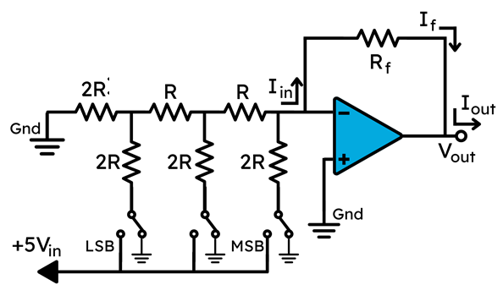
Unit 6: R-2R Ladder DAC
Simple two values of resistances are used as a ladder network.
The resistance remains same no matter how many bit system is designed.
Simpler to fabricate as the range of resistances is tremendously reduced for higher order bits.

Slide 19
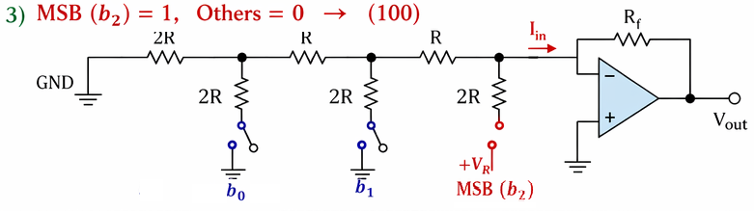
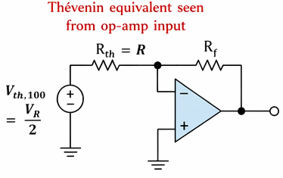
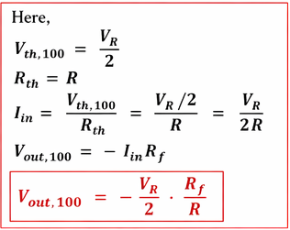
Unit 6: R-2R Ladder DAC
Simple two values of resistances are used as a ladder network.

Slide 20
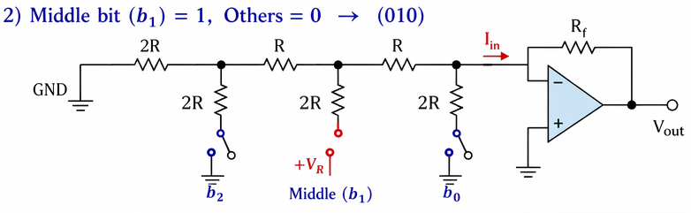
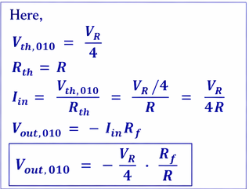
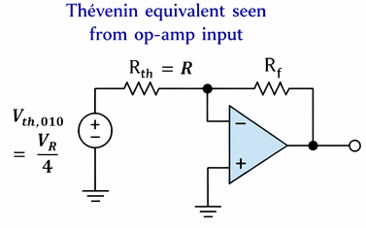
Unit 6: R-2R Ladder DAC
Simple two values of resistances are used as a ladder network.

Slide 21
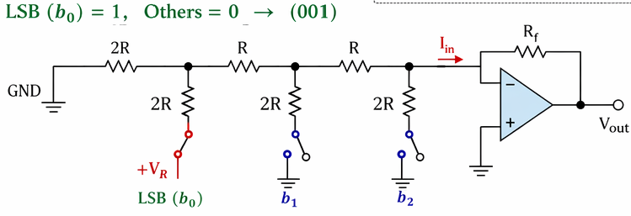
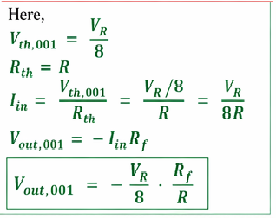
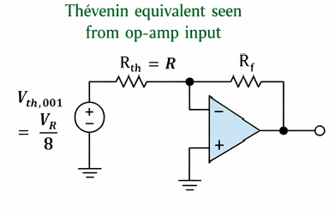
Unit 6: R-2R Ladder DAC
Simple two values of resistances are used as a ladder network.

Slide 22
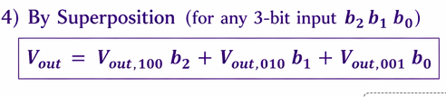


Unit 6: R-2R Ladder DAC
Simple two values of resistances are used as a ladder network.

Slide 23
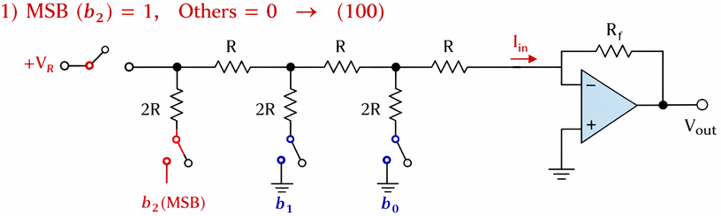
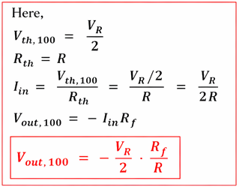
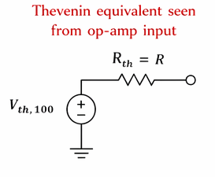
Unit 6: R-2R Ladder DAC
Simple two values of resistances are used as a ladder network.

Slide 24
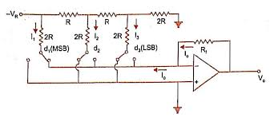

Slide 25
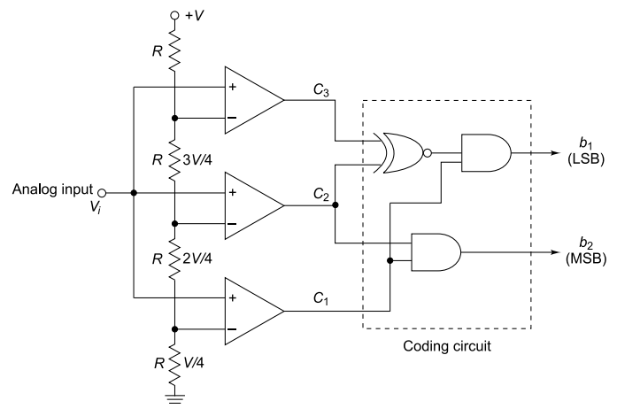
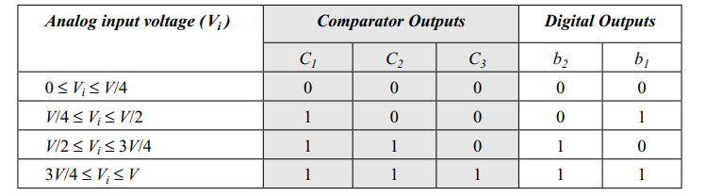
Unit 6: Flash Type ADC

Slide 26
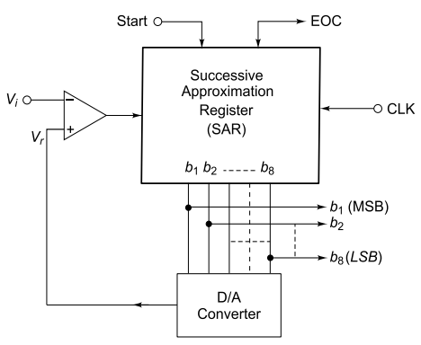
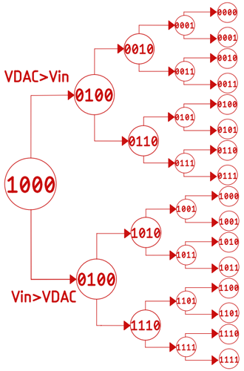
Unit 6: Successive Approximation Type ADC

Slide 27
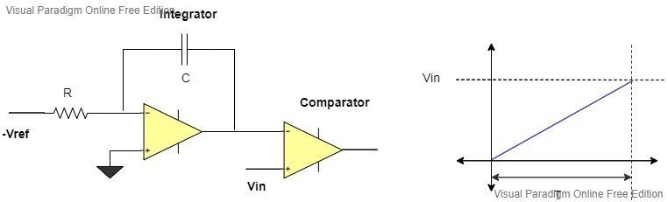


Unit 6: Single slope Type ADC

Slide 28
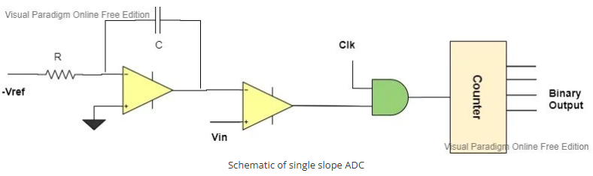
Unit 6: Single slope Type ADC

Slide 29
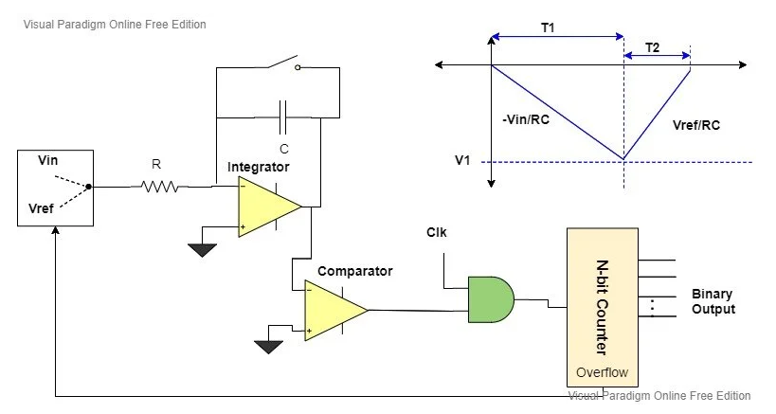

Unit 6: Single slope Type ADC

